Slide 1
How to Build an HR Service Center for the New Millenium
Lori Jefferis | Senior Product Manager | Infor
Sue Anne Berkle | Director of Customer Relations | Bon Secours Health System
Hong Le | Director of HRIS | Inova Health System

Slide 2

What is HR Transformation?
From yesterday to today
Guiding principles and key components
Case study: Bon Secours Health System
Case study: Inova Health System
Trends affecting the future
Notes:
Works – are making other colors of these? Just repeat geometry with diff hues?

Slide 3
First, a question…
What is the biggest challenge you face in your job today?

Slide 4
What is HR Transformation?
Plan to move HR from “administrative” to “strategic”
Drive alignment with the business strategy
Reduce operating costs
Improve efficiency of HR service delivery
Adjust operating model for new technology
Improve quality of service
"HR Transformation is the design, development and implementation of a new HR service-delivery model to deliver HR services in a more efficient, effective and compliant manner."
–J. Preethi, Business Line
Notes:
about 25 years ago, "HR transformation" was a grass-roots movement focused on shifting HR from a largely administrative organization to a more strategic organization. That new work quickly evolved into a broad initiative to transform all HR services. Now, as it has become a standard way of doing business in HR, human resource leaders need to ask themselves what more can be done to help their organizations achieve their strategic goals.

Slide 5
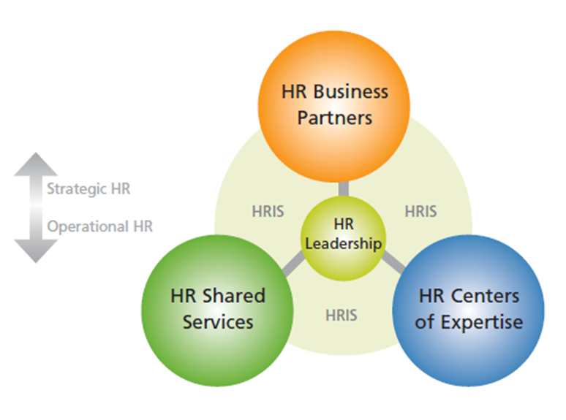
The early days
Four principal building blocks
  Implementing a new way of delivering HR services.
  Using technology to provide employees with direct access to HR information.
  Outsourcing HR work to service providers if they could do it faster, better, cheaper.
  Demonstrating the business value that HR provides by putting metrics in place.
The ‘New’ HR Service Delivery Model
Notes:
http://www.hreonline.com/HRE/view/story.jhtml?id=259960942
1. Implementing a new way of delivering HR services.
The new HR service-delivery model was based on the seminal work of Professor David Ulrich at the University of Michigan and was based on three key components:
* Centers of Excellence as a means of organizing HR professionals who worked on HR policies and programs;
* Shared Services as HR operations centers that leveraged scale; and
* Embedded HR resources (HR professionals and technology) within the business.
Ulrich was one of our spiritual leaders and our first guru. People flocked to hear him at HR conferences and to read his articles and books.
2. Using technology to provide employees with direct access to HR information.
In the early 1990s, computing was undergoing a revolution and personal computers and computer networking began to change the landscape.
At the time, in most organizations, employees had to walk over to the HR department just to ask a simple question or update some basic information. We believed that employees could use a phone or computer to directly access their own HR information and execute their own transactions.
The idea was risky because no one knew for sure if employees would be comfortable using technology to handle HR-related issues. There were a lot of naysayers who doubted our efforts.
3. Outsourcing HR work to service providers if they could do it faster, better and cheaper.
We believed that outsourcing administrative tasks such as HR, payroll and benefits administration to specialized external providers would enable HR to focus more attention on the organization's strategic priorities.
4. Demonstrating the business value that HR provides by putting metrics in place.
Performance metrics that measured cost, quality and speed were critical to building a business case and proving the value of HR Transformation to skeptical business leaders.
The early days were very exciting.

Slide 6
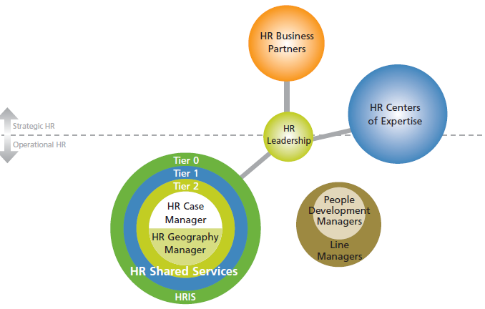
Today
Strategy focused on enabling the organization to meet its specific business needs
An HR function that can provide enhanced value to the business
Next generation HR
Notes:
3 - 5 Years

Slide 7
Key components
Enabling Technology
  HR solutions – HRIS, compensation, recruiting, talent management, learning, payroll
  Shared services – call management, case management, knowledgebase, employee portal, document management
HR Business Partners - consult
HR Contact Center
  Tier 1 = Operational support
  Tier 2 = Escalation
HR Centers of Expertise - design
HR Leadership – governance

Slide 8
Q: Where are you in your HR transformation journey?
Planning & Launching
Implementation & Optimization
1 - 3 Years
3 - 5 Years
Greater than 5
What does your current HR operating model look like?
Does it deliver the combination of efficiency, value and high level of service demanded by your business?
Notes:
Planning & Launching
Implementation & Optimization
1 - 3 Years
3 - 5 Years
Greater than 5
What does your current HR operating model look like?
Does it deliver the combination of efficiency, value and high level of service demanded by your business?

Slide 9
Guiding principles for HR Transformation
Business-driven
Scalable
Repeatable
Standardized
Notes:
Deloitte
Guiding principles for HR Transformation When developing and implementing new HR capabilities, there are a number of useful design principles to consider. These guiding principles can help you create HR Transformation strategies, initiatives, and solutions that make sense for the future.
Business-driven. Consider developing HR capabilities that align with your company’s strategy and business needs. Focus on high-impact HR activities that can create significant value for the business, rather than commodity activities such as transaction processing and administration. Ideally, HR Transformation should be integrated with business strategy, so that new HR capabilities are developed in sync with the business and are readily available when needed. That’s a big shift from the usual approach, where HR is not involved until late in the game and may thus become a bottleneck that slows things down and limits the business’ strategic options.
Scalable. Establish HR capabilities (i.e., systems, processes, programs, infrastructure) that can effectively, easily, and efficiently adjust to changes in business demand — whether that means scaling back in the face of a global slowdown, Global Business Driven HR Transformation: The Future Starts Now ratcheting up for growth, or navigating the twists and turns of local markets.
Repeatable. Develop demonstrated HR capabilities that can be rapidly and efficiently deployed in new situations — instead of reinventing the wheel by treating each new challenge as a one-time occurrence. Repeatability is especially important for business events that are likely to recur, such as new market entry, M&A, and global mobility.
Standardized. Create HR systems, processes, and policies that are as standardized as much as possible. Standardization can improve efficiency, consistency, and collaboration across the global enterprise — and makes it easier to move resources across global boundaries. The default approach for HR Transformation should be “why not standardize?” Although there are situations where a nonstandard solution is truly justified, those situations are the exception rather than the rule. In the manufacturing business, there’s a saying that 80% standardization beats 100% variation, and the same philosophy applies to HR.

Slide 10
Today…
More than eight in 10 HR organizations are either currently transforming HR – or planning to do so
Global
Scope expanded from core HR administrative operations to all HR services
  Talent
  Learning and development
  Recruiting
  Staffing

Slide 11

Providing Good Help to Our Employees
The Bon Secours HR Transformation Journey
strategies for aligning HR

Slide 12
Agenda
Who is Bon Secours Health System?
Overview of the culture
Implementation
The role of technology
Lessons learned
Current challenges
Next steps
strategies for aligning HR

Slide 13
The Ministry
A $3.4 billion not-for-profit
Catholic health system, Bon
Secours owns, manages, or joint ventures:
19 Acute Care Hospitals
  14 Owned
  5 Joint Ventured
1 Psychiatric Hospital
5 Nursing Care Facilities
4 Assisted Living Facilities
6 Retirement Communities / Senior Housing
14 Home Care/Hospice Providers
Our 25,000 caregivers help people in 9 communities in 6 states
Bon Secours New York Health System
Riverdale, NY
Bon Secours Charity Health System
Suffern, Warwick. Port Jervis, NY
NY
MD
Bon Secours Kentucky Health System
Ashland, KY
KY
VA
Bon Secours Baltimore Health System
Baltimore, MD
Bon Secours Virginia Richmond Health System
Richmond, VA
Bon Secours Virginia
Hampton Roads Health System
Hampton Roads, VA
SC
Bon Secours St. Francis Health System
Greenville, SC
Roper St. Francis Healthcare
Charleston, SC
FL
Joint Venture
Owned
Bon Secours St. Petersburg
St. Petersburg, FL

Slide 14
HR Transformation Approach
Assess Current State and Define Future State Requirements
Design Conceptual, High-Level Future State Service Delivery Model
Cost Benefit Analysis and Implementation Roadmap
Conducted work distribution and process fragmentation analysis to determine HR employees’ time allocation and process efficiency against a set of leading services
Conducted Voice of Customer interviews to determine the perception of HR current performance and get insight into the future state business requirements of HR
Conducted organizational analysis of current structure and size and benchmarked against leading practice
Conducted financial analysis of current HR spend in three operational areas (salary, vendor, and technology expenses)
Developed HR future state design guiding principles
Defined conceptual, high-level future state HR organizational roles and responsibilities, HR service offering
Defined future state conceptual operating model structure and sizing against leading practice benchmarks
Identified the operational improvements to support the new operating model
Conducted a HRIS capability assessment to support future state operating model
  Developed 3-year business case to include benefits and costs to implement proposed service delivery model
  Conducted change impact assessment to understand organizations readiness to adopt new model
  Prioritize service delivery model changes and developed an implementation roadmap
  Establish a Governance structure and project workstreams
  Socialized the model, business case, and implementation roadmap with key stakeholders
strategies for aligning HR

Slide 15
Strategy & Planning
Planning, Governance, & Communications
Diversity & Inclusion
Total Rewards
Compensation
Benefits and Health & Well Being
Strategic Human Resources
Human Resources Executives
Advisory and Policy Services
Talent Management
Talent Acquisition & Workforce Planning
Talent Development & Organizational Effectiveness
Bon Secours Human Resources Operating Model
COE Roles & Responsibilities
Provide HR planning, governance and communications services including strategy, planning and budgeting
Lead the organization’s diversity and inclusion strategy
Provide compliance management including risk management, policy and compliance development and labor management
Coordinate overall project management ensuring alignment with BSHSI SQP
BSHSI SQP
COE Roles & Responsibilities
Support overall total rewards strategy and design for organization. Develop and implement compensation and benefits strategies, policies, procedures and products including base, incentives, retirement and health and welfare
Collaborate with other COEs and Shared Services to implement compensation and benefits products and services
Comply with total rewards regulatory and audit requirements
Manage total rewards industry benchmarking and reporting analysis
Good Help
…to our customers
COE Roles & Responsibilities
Develop and implement strategy, policies,
procedures and guidelines for Talent
Management
Partner with COEs and Shared Services to implement talent management programs & tools
Conduct internal and external talent management benchmarking activities and update tools and methodologies
Support recruitment strategy, design and administration
Support workforce strategy and program design, succession strategy and program design, performance management design and organizational development
COE Roles & Responsibilities
Collaborate with senior business leadership/management within a business design and business strategy execution. Provide HR consultative solutions to drive business results.
Provide advice and counseling to employees and managers on employee-related issues
Support policy development, employee advocacy, diversity programs, disciplinary action administration
Understand business strategy and translate imperatives to COEs and Shared Services
Serve as the face of the business to HR and the face of HR to the business
Human Resources Operations Center
Tier 0 Shared Services
Roles & Responsibilities
  Provide day-to-day management of core HR operating model activities.
  Serve as the first point of contact for HR-related inquiries
  Provide support to CoEs and Business through HR transaction processing, data management and reporting services
  Provide strategy, design and maintenance of HR technology systems that enable seamless tracking and work transfer across HR operating model
  Support employee records admin, transaction processing and reporting, employee records, employee transfer processing, relocation, severance plan admin, outplacement admin, service award recommendation, and performance mgmt. administration
Tier 1 Shared Services
Tier 2 Shared Services
HR Operations
HR Technology
8
Position Manager
HealthStream
Success Factors
Benefits
ESS/MSS
Core HR
Kronos
Harmonized Processes
Harmonized Programs
Service Level Agreements

Slide 16
HROC’s Structure
Service Advisory
Talent Management
Total Rewards
Data Management
Primary Role
Primary Role
Primary Role
Primary Role
Employee & Manager Inquiries and Resolution
Content Management
Customer Relations
Talent Acquisition Administration
Learning & Development Administration
Performance Management Administration
Benefits Administration
Compensation Administration
Leave Management Administration
Service Advisory Escalation Resolution
Employee Record Administration
Transaction Processing
Vendor Management
Reporting & Analytics
strategies for aligning HR

Slide 17
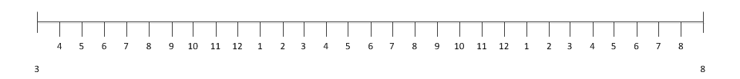
Approach and Target Timeline
Initiative Timeline
Initiative I
TA, Tier II, S&P
Go-Live 8/31/12
Initiative III
TR, Tier II
Go-Live 4/30/13
Initiative V
TM, Tier II
Go-Live 3/31/14
Initiative II
Policies, H&WB, Tier I, Tier II, HR Tech, HR Ops Go-Live 2/28/13
Initiative IV
SHR
Go-Live 10/31/13
Months
0 | 1 | 2 | 3 | 4 | 5 | 6 | 7 | 8 | 9 | 10 | 11 | 12 | 13 | 14 | 15 | 16 | 17 | 18 | 19 | 20 | 21 | 22 | 23 | 24 | 25 | 26 | 27 | 28 | 29 | 30
3/1/12
Legend
8/31/14
Sequencing and Prioritization Criteria
 | FYE 2012 |  | FYE 2013 |  | FYE 2014
Financial Impacts: Ability to realize early financial savings
HR Lifecycle Events: Timing and impact to organization
Technology dependencies: Degree of anticipated configuration changes to the current HRIS technology platforms
COE Maturity: Degree of COE’s current alignment to new model
Existing presence of Shared Services: Degree to which COE Shared Services Center capability is already developed
Subsequent COE Implementations: Degree to which a COE Initiative facilitates other implementations
strategies for aligning HR

Slide 18
Implementation Methodology
During implementation, each initiative transitioned through six stages and followed a sequential order based on a set of prioritization criteria. While we anticipated many of these initiatives would run parallel to one another, we tried to execute them sequentially.
Implementation Stages and Key Activities
Refresh
Strategy
Harmonize
Policies
Develop Procedures
Build
Technology
Test
Workforce Transition
Refine strategy to support new operating model
Inventory all policies and processes
Conduct fit-gap analysis to leading practice
Make recommendations and harmonize policies
Design BSHSI processes that are scalable and repeatable
Develop process workbooks
Develop operational procedures
Conduct change impact assessment
Design call center scripts
Develop configuration workbooks
Update Lawson configuration
Update point solutions
Conduct user acceptance, system integration, and parallel testing for Lawson updates
Develop role profiles and talent assessment tool
Develop workforce transition plan
Develop course curriculum
Develop Web Based Training (WBT) materials
Develop Instructor Lead Training (ILT) materials
Conduct training
strategies for aligning HR

Slide 19
Challenges We Needed to Overcome for Implementation
A large percentage of employees did not have or use email
Healthcare is a 24/7/365 operation with multiple shifts; HR has historically been one shift from 8 AM to 5 PM
Decentralized operating model with high amount of variation
Many of the current HR staff did not have the skills and competencies needed for their future state roles
Effectiveness of third-party vendors and interfaces
Enwisen/Lawson integration
strategies for aligning HR

Slide 20
Enabling Technologies
Lawson
  Manager self-service
  Employee self-service
Enwisen
  Case management
  Knowledgebase
Uptivity
  Call recording
  Call QA
  Live monitoring
  Screen capture
Cisco
  Telephony system
Intellias
  Benefits enrollment tool
Healthcaresource
  Applicant tracking system
SuccessFactors
  Performance management
  Compensation management
ImageNow
  Electronic employee files
SharePoint
Cameo
  Reporting tool for telephony system
strategies for aligning HR

Slide 21
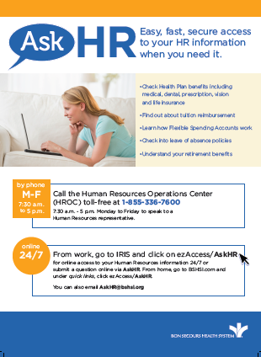
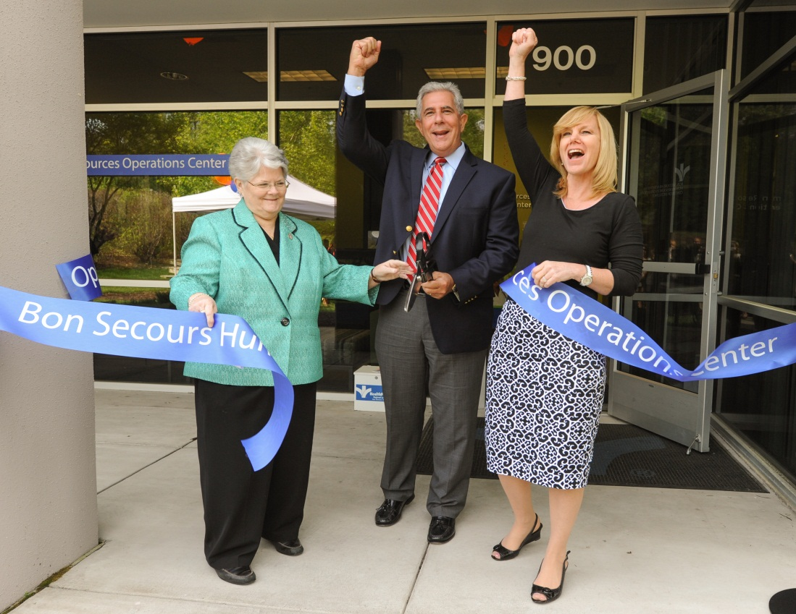
May 5, 2014: HROC Go-Live
strategies for aligning HR

Slide 22
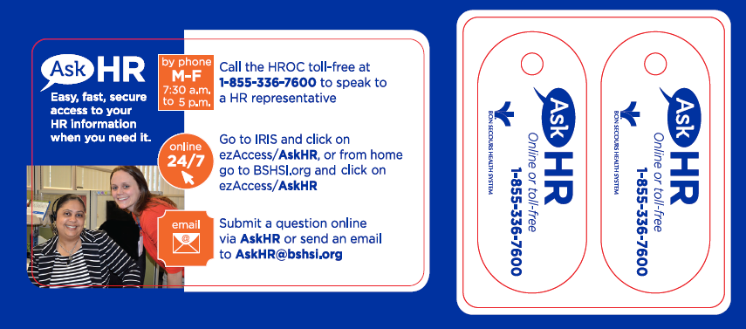
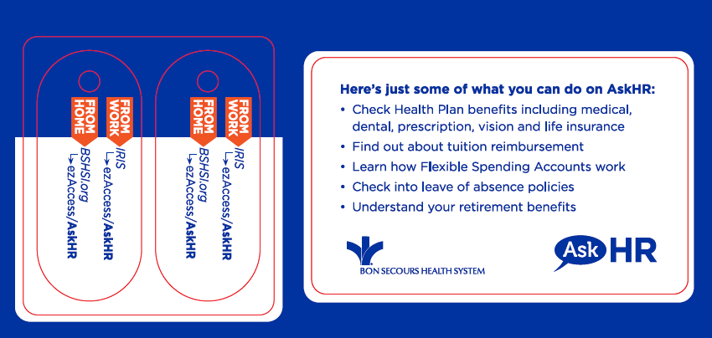
Promoting the HROC: Cards & Key Fobs
strategies for aligning HR

Slide 23
Statistics from Year One
Number of cases in Enwisen: 90,354
Number of Enwisen portal hits: 133,197
Number of Service Advisory AskHR phone calls: 56,786 received; 55,239 handled with an overall abandon rate of 2.7%
Percentage of AskHR calls resolved by Tier 1: ~68 percent
Number of transactions processed: 49,662
Number of positions filled/onboarded: 6,601
Number of tuition request/reimbursements processed: 3,445
Number of leave of absence cases managed: 3,946 (since January)
strategies for aligning HR
Notes:
Check on order of slides here

Slide 24
Successes from Year One
Began supporting the Charity market on July 1, 2014
Eliminated third party vendor for benefits enrollment tool support
Implemented Intellias in May 2015
Positive mock survey results
Successfully handled our first open enrollment in-house
Employee survey yielded opportunities for both short and long-term improvement
Leadership retreat – created three-year plan for the HROC with 5 bold steps
strategies for aligning HR

Slide 25
5 Bold Steps
Each bold step is championed by one of the HROC leaders:
  Build relationships and partnerships
  Maximize technology and automation
  Inspire right people, right roles, right time
  Implement quality controls
  Advocate for harmonization around processes, policies, and benefits
strategies for aligning HR

Slide 26
Challenges We Overcame In Year One
Changed our hours of operation
  Originally M – F, 7:30 AM to 5:00 PM with 3 different shifts
  Changed to M – F, 8:00 AM to 5:00 PM with 1 shift
Designed custom reports to better understand volume and trends and to better manage staffing
Career path creation for Tier 1 and associated turnover
Changed lunch schedules to extend timeframe by 30 minutes and reduced abandon rate
Implemented new in-house benefits enrollment tool (Intellias)
strategies for aligning HR
Notes:
Check on order of slides here

Slide 27
Challenges We Currently Face
Leave of Absence/FMLA volume
Meeting SLAs
Managing call-backs
Planning for the possibility of an active enrollment
Technology changes and enhancements
Retention of high potential/high performers
Tier 1 engagement
Divesting our Charity market
Incorporating Rappahannock Hospital into BSHSI
strategies for aligning HR
Notes:
Check on order of slides here

Slide 28
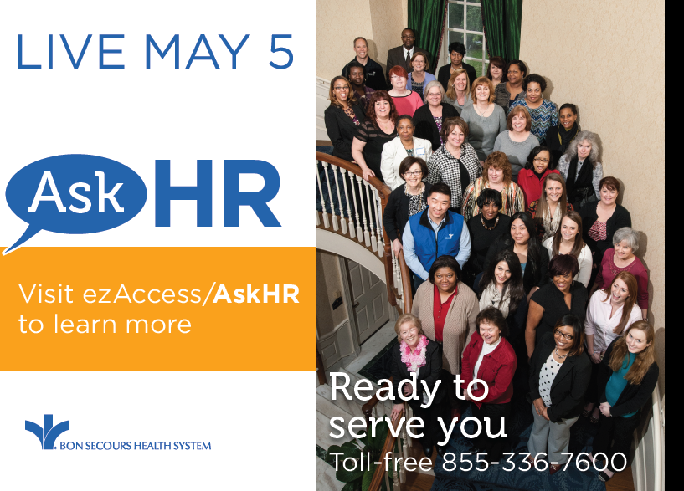
Lessons Learned from Transformation
Training
  Duration
  Quality
Hiring
  The right skillset
Importance of communication and branding
Top-down buy-in
Daily touchpoints – helped to mitigate problems
Allow time to prepare the organization for the magnitude of the change
strategies for aligning HR

Slide 29
Next Steps
Plan for an active benefits enrollment
Technology enhancements and upgrades
Process improvement & optimization
Reconvene the Policy Harmonization Team
Continue visiting/networking with others
HROC staff development and retention plans for high potential/high performers
Revisit the design of HROC
  What’s working? What’s not working? What could we improve?
strategies for aligning HR

Slide 30
HR Shared Services Inova eServices Center

Slide 31
Agenda
Why we implemented a Shared Service Center
.HR Model
HR Process
Measurement
Training
How do we measure our progress
  Customer Satisfaction
  Process Improvement

Slide 32
Why the Service Center
Alleviate the transactional tasks from the Human Resources department
Allows the Business Partner (former HR Consultants) to be strategic partners with their client group.
Standardization amongst all of the Human Resources Departments
HR information available to employees 24/7
Centralized and more customer focused onboarding process

Slide 33
HR Model
Past | Current
6 Operating Units 6 Independent / decentralized HR departments HR VP HR Directors HR Consultants HR Specialist Recruitment Manager Recruiter Recruitment Coordinators | 6 Operating Units 6 HR departments VP of HR HR Directors HR Business Partners Talent Coordinators Director HRIS and Shared Services HR Shared Services Manager Team Lead Representative, Tier 1 Assistant Recruitment Manager Recruiter Recruitment Coordinators

Slide 34
Process
Past | Current
HR Department Receive various HR inquires via phone/ email Payroll inquires Benefits inquires Compensation inquires Process transactional items Policy interpretation Employee relations Recruitment Interview/ selection New hire onboarding | HR Shared Services Center New hire onboarding Receive various HR inquires via phone/ email Payroll inquires Benefits inquires Compensation inquiries Process transactional items Self-service model HR Department Strategic partners with management: training and development, department reorganization, employee engagement, employee relations Recruitment Interview/ selection

Slide 35
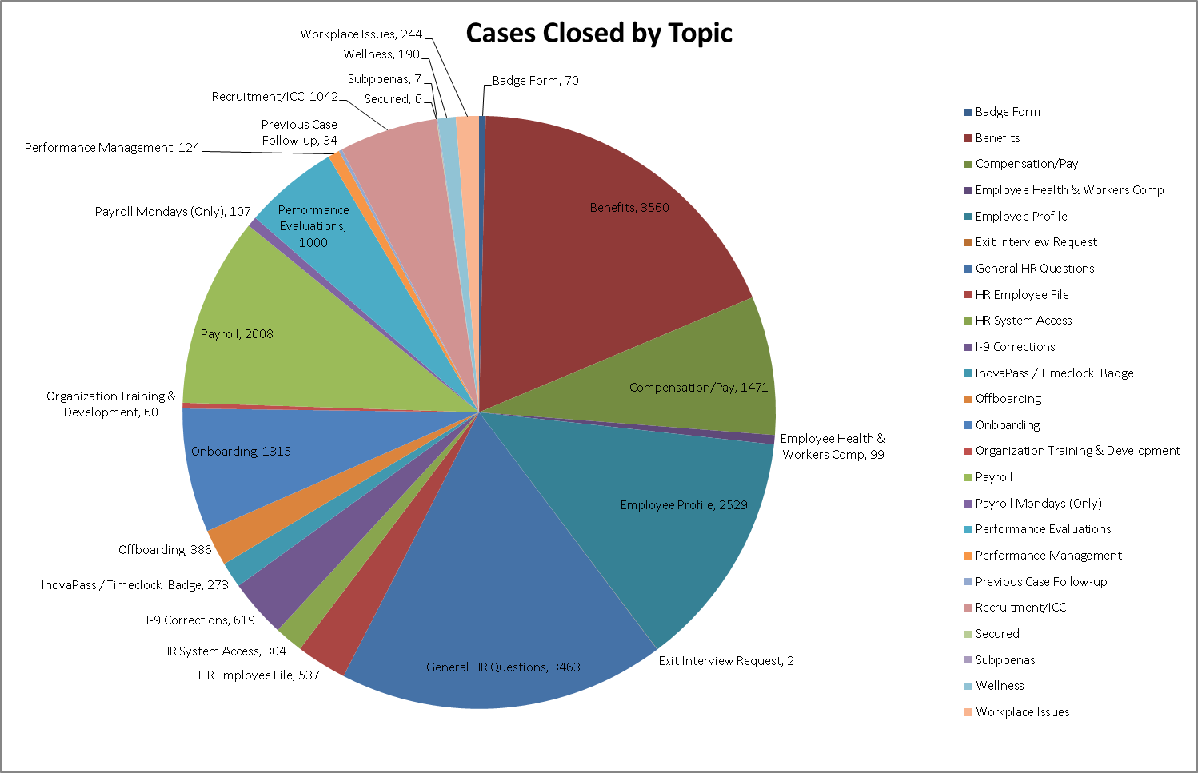
Cases By Topics

Slide 36
Average Days to Resolve

Slide 37
Expectations and Productivity Report – Coming…
Expectations
Closing a minimum of 30 cases a day
Tier 1 level cases will be resolved within one business day
Tier 1 level cases will be also escalated to Tier 2 within one business day.
The time it takes to answer a call (ring time) should be no longer than 30 seconds
All phone calls that come through the service center should have a case associated with it including follow-up calls of current cases.
Process candidates’ onboarding daily
Productivity Report
Develop a daily, weekly and quarterly report

Slide 38
Training
Current | Future
Develop a comprehensive Training Manual / Guide for your Team This will make onboarding more structured Develop a training competency Checklist to track training progress Incorporate your Subject Matter Experts in the Program Incorporate Customer Service Training especially dealing with difficult customers (Teams biggest frustration) Standardization Create and continuously update your SOPs (Standard Operating Procedures) | Develop Onboarding Training Toolkit for New Staff Develop Hot Topics Scenarios Develop Quarterly Quiz Package Develop The Training Focused Package Standardization Develop standard responses for your most asked questions This will save your team time and ensure accuracy and consistency

Slide 39
Future - HR Shared Services
Current | Future
Director HRIS and Shared Services HR Shared Services Manager Team Lead Representative, Tier 1 Assistant | Director HRIS and Shared Services HR Shared Services Manager Team Lead Coordinator Representative, Tier 1 Assistant HRIS, Tier 2 Benefits, Tier 2

Slide 40
Surveys
Continuing to improve the customer satisfaction by using knowledgebase and cases surveys.

Slide 41

Inova eServices Center
Thank You!

Slide 42

Q: How has your HR transformation contributed to your organization’s competitive advantage?

Slide 43

Trends affecting the evolution of shared services
Notes:
works

Slide 44
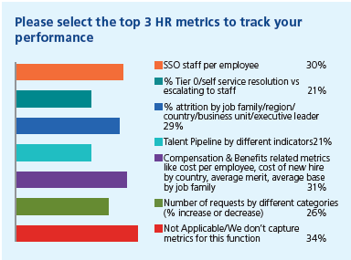
Where is the SSO industry today?
North America ranks number one for SSC location
Most businesses have under 100 FTEs
Organizations are at different levels of maturity, with North America lagging behind other regions
Practitioners are relying more heavily on outsource partners
Cost cutting is table stakes while impact on output/business performance becomes a key metric

Slide 45
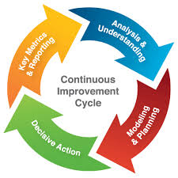
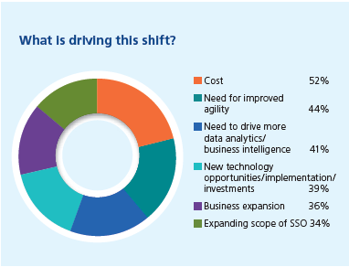
Optimizing service delivery
Process optimization
Key drivers include cost, new technology, business expansion, improved agility and data analytics
Technology is an enabler to achieving this
Continuous improvement driven by analytics is a means of achieving process excellence
Outsourcing for improved cost, more automation, and higher quality
Notes:
One of the megatrends we have identified across shared services
organizations worldwide is process optimization, or “the
need to support client growth with reduced budgets”. Many
practitioners see data analytics as key to unlocking process
optimization, and technology as a means of delivering it more
effectively.
One respondent described her ideal as “an agile and scalable
model, which cost-effectively services business expansion”.
Despite the fact that cost has been identified as table stakes,
respondents still list it as a key driver for optimization, though
“new technology”, “business expansion”, “improved agility”
and “data analytics” are all contenders for the lead.
A significant majority lists technology as enabling optimization.
In a follow-up interview, one practitioner explained that his
company was currently reversing an outsourcing agreement and
was “relying on new technology, agility and data analytics” to
deliver improved performance.
Global business services or multifunctional services are among
the most popular models for optimizing processes, but
expanding scope of service, customer base, and geographies are
also key strategies.
Process excellence is a priority for most SSOs, and Continuous
Improvement the most popular means of achieving this,
according to the survey. What’s interesting to note is that data
analytics is widely recognized as a reliable means of driving it.
And while process excellence is generally built into job
descriptions there has been strong growth in the number of
Centers of Excellence that offer CI support.
outsourcing continues to solve a number of operational challenges, such as:
■ Reducing costs: 78% of companies indicated that cost savings was a key driver for
outsourcing. Among this group, 65% reported that they achieved their expected
cost-reduction targets.
■ Access to outside expertise: 78% of participants indicated this was a key objective.
In addition to looking for specific domain expertise, companies turn to outsourcing
to avoid large capital investments in technology as well as the recurring expense of
ongoing maintenance and upgrades.
■ Improving service quality: 74% of companies indicated this was a key driver of
their decision to outsource. Considered the most common measure of success,
81% indicated that they had met or exceeded their service quality targets.
■ Realigning/focusing on strategic HR priorities: 72% of organizations cited this as
a key driver. Outsourcing allows organizations to shift their focus from the
time-consuming administration of non-strategic processes, so they can focus on more
value-added activities that support the business.

Slide 46
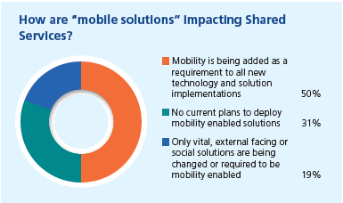
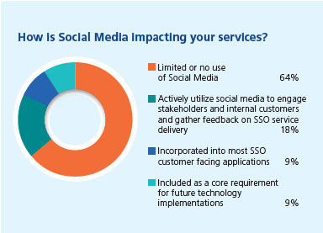
Leveraging digital and automation technology
Focus on end-to-end process management…workflow management is a leading contender for future investments
Self-service and mobile technology
Obstacles to implementation include limited support and cost
The single most significant enabler of improving value in future

Slide 47
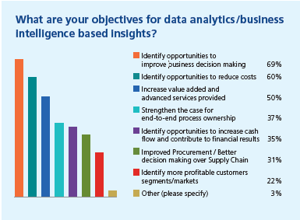
Data analytics and reporting
Business intelligence for smarter decision-making based on facts and outcomes
Shared services starting to include a data analytics role
Levels of maturity are progressing
Mining data from processes and systems is becoming the “new normal”
Notes:
Workforce metrics and measurement. Expertise will be required to help the organization report on, understand and mange human capital metrics – equipping it with the tools to convey trends in workforce data, identify areas at risk, or analyze the return and impact of specific HR initiatives

Slide 48
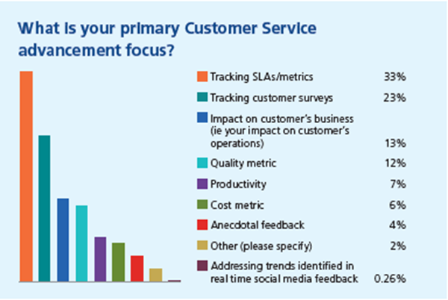
Customer service
Gather real-time satisfaction metrics on the basis of transactions versus annually
Significant opportunities to expand service to more of the customer base
Face-to-face customer satisfaction reviews
Notes:
Key Trend: Increased Focus on Customer-Centric Shared Services Models
As organizations evolve in terms of service delivery strategy and structure, they are
focusing more on serving the customer and providing an optimal user experience.
Organizations are aligning their shared services models to the needs—and in some cases,
the structure—of the business. Components of a customer-centric approach include:
■ A user-friendly employee/manager portal that facilitates self-service
■ Call centers staffed with knowledgeable specialists to solve problems for employees
and managers
■ An integrated technology platform that improves reporting capabilities
■ Clear service level standards that define expectations and create accountability for
delivering enhanced value through the shared services solution
A key issue here is that as technology, particularly self-service, is
driving out transactional work, the roles that remain are increasingly
focused on services that directly impact customer satisfaction.

Slide 49
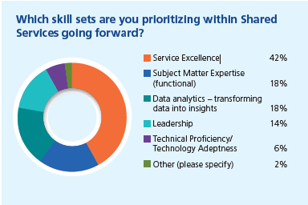
Evolving talent and skills
Quality staff differentiates good service from excellent service
Consider technical proficiency as a higher priority
Increase focus on upgrading staff skills and delivering more of the services their customers are demanding

Slide 50

Tomorrow
A new paradigm: integrated employee services in which employees are viewed as consumers
Shift focus from cost reduction to employee experiences
Metrics that:
  Assess outcomes rather than internal processes
  Span functional areas
  Expand to include employee/manager satisfaction, net promoter score, employee engagement and retention, workforce productivity
Components of evolution
  Redefine the business services model
  Innovate and expand scope of services
  Deliver insights and take actions
  Identify the right lead to deliver business outcomes

Slide 51
Q: Have you defined guiding principles for the future-state vision of how HR will operate?
How will HR shared services fit into your future business strategy?
Which of the five trends do you plan to leverage?

Slide 52

Questions?

